Slide 1
K-Nearest Neighbor

Slide 2
K-Nearest neighbor
Instance based learning- also called lazy algorithm
  When we get the training examples we do not process them and learn the model instead we just store the examples
  And when we need to classify an instant that time we process
  Algorithm does not come up with the model apriori rather when it gets the test instance it uses the stored instances in memory in order to find the possible model
Non-linear model
Very compute intensive
Decision boundary is a curve
default parameter for the number of neighbors k
  5

Slide 3
How does it do it?
For a given new instance
  find what is the closest instance
  find the y value of that closest instance
  guess this y values as the y- value of the test instance.
How to find most similar instance/some neighbouring (most nearest) instances
  We can use similarity metrics (or distance functions) depending on the type of data that we have
    Euclidean distance, Cosine and other

Slide 4
1-nearest neighbour
Training phase
  save the examples
Prediction time
  get the test instance (xt)
  find the training example (xi,yi) that is closest to test instance (xt)
  predict the yi as the output yt

Slide 5
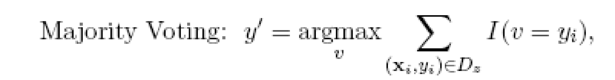
K-nearest neighbour
Training phase- save the examples
Prediction time- get the test instance (x_{t}) and find k training example (x₁,y₁), (x₂,y₂)…(x₃,y₃) that are closest to test instance (x_{t}) and we predict
    the majority class (most frequent) from y₁, y₂, …..y_{k} as the output y’
    Where v is the class label, y_{i} is the class label for one of the nearest neighbours and I(.) is an indicator function that returns the value 1 if its argument is true and 0 otherwise.

Slide 6
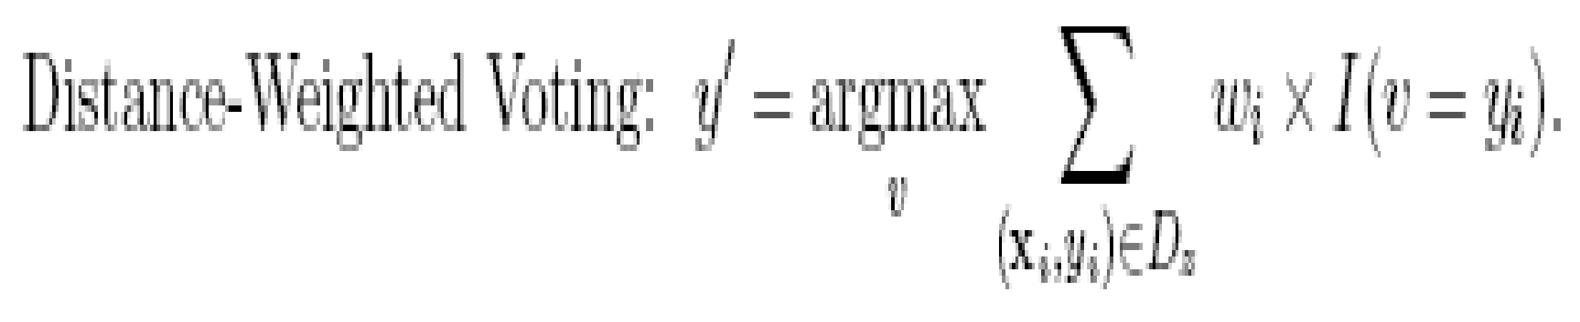
Distance-weighted voting scheme
In the majority voting approach, every neighbor has the same impact on the classification.
This makes the algorithm sensitive to the choice of k
One way to reduce the impact of k is to weight the influence of each nearest neighbor xi according to its distance: w_{i}= 1/d (x’, xi)²
As a result, training examples that are located far away from z have a weaker impact on the classification compared to those that are located close to z.
Using the distance-weighted voting scheme, the class label can be determined as follows:

Slide 7
improvements/issues of concern
Weighting examples from the neighbourhood in case of k>1
How to measure closeness
  Many distance functions
How to find the closest points quickly
  We must use some good data structure or method to store training examples so that we don’t need to go through all the training examples, find the distance and come up with the nearest data point

Slide 8
Dataset
Category 1
y
Category 2
x

Slide 9
Category 1
New data point
Category 2

Slide 10
Result of K-NN
Category 1
New data point assigned to category 2
Category 2

Slide 11
How to prepare model
1. Choose the number K of neighbors
2. Take the K-nearest neighbors of the new data point, according to the Euclidean distance
3. Among these K neighbors, count the number of data points in each category
4. Assign the new data point to the category where you counted the most neighbors

Slide 12
Category 1
New data point
Category 2

Slide 13
5-NN
Category 1
New data point
Category 2

Slide 14
5-NN
Category 1
New data point
Category 2

Slide 15
5-NN
Category 1
New data point
Category 2

Slide 16
5-NN
Category 1
New data point
Category 2

Slide 17
5-NN
Category 1
New data point
Category 2

Slide 18
5-NN
Category 1- 2 neighbors
Category 2- 3 neighbors
Category 1
New data point
Category 2

Slide 19
For more than two classes
For more classes, we count how many neighbors belong to each class and again predict the most common class.

Slide 20
Algorithm
Load the data
Initialize K to your chosen number of neighbors
3. For each example in the data
  3.1 Calculate the distance between the query example and the current example from the data.
  3.2 Add the distance and the index of the example to an ordered collection
4. Sort the ordered collection of distances and indices from smallest to largest (in ascending order) by the distances
5. Pick the first K entries from the sorted collection
6. Get the labels of the selected K entries
7. If regression, return the mean of the K labels
8. If classification, return the mode of the K labels

Slide 21
In cases where we are taking a majority vote (e.g. picking the mode in a classification problem) among labels, we usually make K an odd number to have a tiebreaker.
for non-binary classification k can have any even or odd value

Slide 22
Importing the libraries
import numpy as np
import matplotlib.pyplot as plt
import pandas as pd

Slide 23
Importing the dataset
dataset = pd.read_csv('Social_Network_Ads.csv’)
x = dataset.iloc[:, :-1].values
y = dataset.iloc[:, -1].values
Age EstimatedSalary Purchased
19 19000 0
35 20000 0
26 43000 0
27 57000 0
19 76000 0
27 58000 0
27 84000 0
32 150000 1
25 33000 0
Total- 1000 entries

Slide 24
Splitting the dataset into the Training set and Test set
from sklearn.model_selection import train_test_split
x_train, x_test, y_train, y_test = train_test_split(x, y, test_size = 0.25, random_state = 0)

Slide 25
Feature Scaling
from sklearn.preprocessing import StandardScaler
sc = StandardScaler()
x_train = sc.fit_transform(x_train)
x_test = sc.transform(x_test)

Slide 26
Training the K-NN model on the Training set
from sklearn.neighbors import KNeighborsClassifier
classifier = KNeighborsClassifier(n_neighbors = 5, metric = minkowski, p =2)
classifier.fit(X_train, y_train)

Slide 27
Predicting a new result
print(classifier.predict(sc.transform([[30,87000]])))
Output
  [0]

Slide 28
Predicting the Test set results
y_pred = classifier.predict(X_test)
print(np.concatenate((y_pred.reshape(len(y_pred),1), y_test.reshape(len(y_test),1)),1))

Slide 29
Making the Confusion Matrix
from sklearn.metrics import confusion_matrix, accuracy_score
cm = confusion_matrix(y_test, y_pred)
print(cm)
accuracy_score(y_test, y_pred)

Slide 30
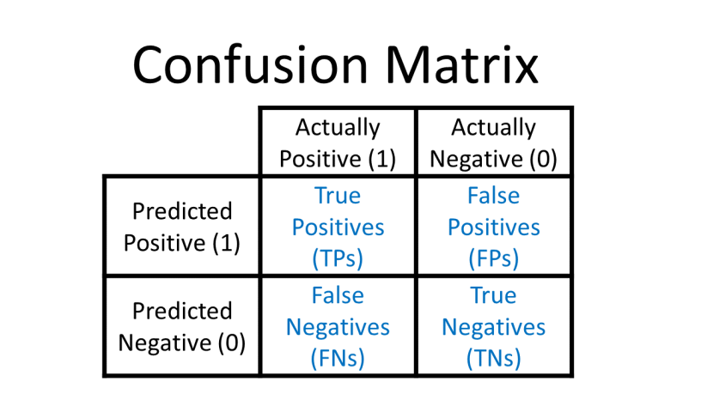

Slide 31
Visualising the Training set results
from matplotlib.colors import ListedColormap
X_set, y_set = sc.inverse_transform(X_train), y_train
X1, X2 = np.meshgrid(np.arange(start = X_set[:, 0].min() - 10, stop = X_set[:, 0].max() + 10, step = 1),
np.arange(start = X_set[:, 1].min() - 1000, stop = X_set[:, 1].max() + 1000, step = 1))
plt.contourf(X1, X2, classifier.predict(sc.transform(np.array([X1.ravel(), X2.ravel()]).T)).reshape(X1.shape),
alpha = 0.75, cmap = ListedColormap(('red', 'green')))
plt.xlim(X1.min(), X1.max())
plt.ylim(X2.min(), X2.max())
for i, j in enumerate(np.unique(y_set)):
plt.scatter(X_set[y_set == j, 0], X_set[y_set == j, 1], c = ListedColormap(('red', 'green'))(i), label = j)
plt.title('K-NN (Training set)')
plt.xlabel('Age')
plt.ylabel('Estimated Salary')
plt.legend()
plt.show()

Slide 32
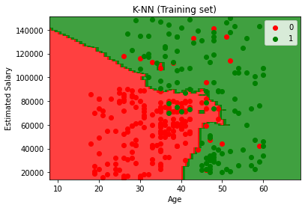
Output

Slide 33
Visualising the Test set results
from matplotlib.colors import ListedColormap
X_set, y_set = sc.inverse_transform(X_test), y_test
X1, X2 = np.meshgrid(np.arange(start = X_set[:, 0].min() - 10, stop = X_set[:, 0].max() + 10, step = 1),
np.arange(start = X_set[:, 1].min() - 1000, stop = X_set[:, 1].max() + 1000, step = 1))
plt.contourf(X1, X2, classifier.predict(sc.transform(np.array([X1.ravel(), X2.ravel()]).T)).reshape(X1.shape),
alpha = 0.75, cmap = ListedColormap(('red', 'green')))
plt.xlim(X1.min(), X1.max())
plt.ylim(X2.min(), X2.max())
for i, j in enumerate(np.unique(y_set)):
plt.scatter(X_set[y_set == j, 0], X_set[y_set == j, 1], c = ListedColormap(('red', 'green'))(i), label = j)
plt.title('K-NN (Test set)')
plt.xlabel('Age')
plt.ylabel('Estimated Salary')
plt.legend()
plt.show()

Slide 34
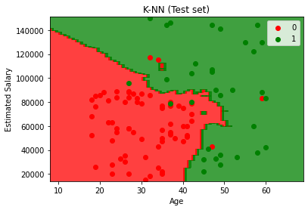
Output

